Slide 1
Phylogenetics
Notes:
Philip Compeau Covid Data: https://compeau.cbd.cmu.edu/online-education-projects/sars-cov-2-software-assignments/sars-cov-2-evolutionary-tree-multiple-alignment-challenge/
Markdown cheat sheet: https://www.markdownguide.org/cheat-sheet/

Slide 2
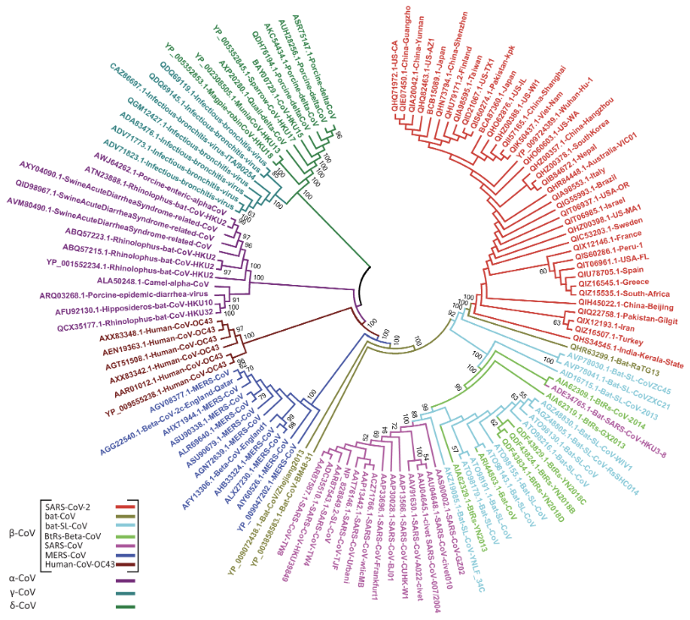
What is phylogenetics?
Using genetics to study evolutionary history
Relationships among:
Species
Individuals
Genes

Slide 3
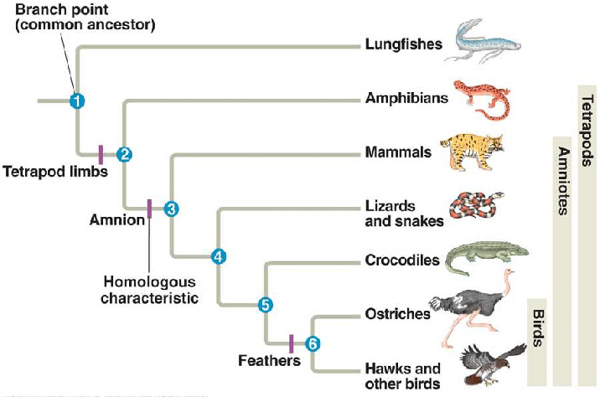
Phylogenetic trees show evolutionary relationships
Closer together → more genetic overlap
Clade
An ancestor and all its descendants
Notes:
Closer branches more overlap
Each clade has at least one shared trait

Slide 4
What is a FASTA file?
A text-based file format
Commonly used in nucleotide sequences or peptide sequences
Example:
>seq1 Description of sequence 1
ATGCGTACGTAGCTAGCTAG
>seq2 Description of sequence 2
GATTACAAGGCTAGCTAGCA
Header line: sequence identifier and description (optional)
Sequence (much longer)

Slide 5
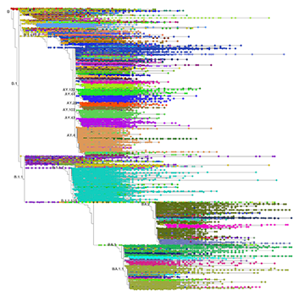
Phylogenetics can inform public health policies
Useful for tracking the growth in COVID variants
Rapid genome sequencing → determine location someone was infected
Notes:
This was especially helpful at the beginning of the pandemic when “The first four cases of COVID-19 in New South Wales, Australia, were found to be closely related to the dominant strain of SARS-CoV-2 found in Wuhan, through genome sequencing and these first four cases were all in people who had recently returned from traveling in China” https://www.news-medical.net/health/Viral-Clades-of-SARS-CoV-2.aspx
Phylogenetics was helpful for tracking and tracing COVID origins and limiting travel during the pandemic.
Image: Tree of 10 million covid sequences from uc santa cruz - the largest tree of genomic sequences of a single species ever assembled as of 2022 https://news.ucsc.edu/2022/06/10-million-sequences.html

Slide 6
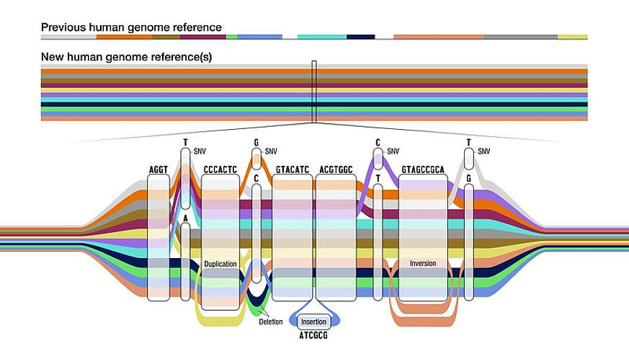
PanMAN tool developed at UCSD!
Notes:
Image: visual representation of a pangenome
PanMAN Tool (Pangenome Mutation-annotate Network)
Pangenome: entire set of genes from all strains within a clade

Slide 7
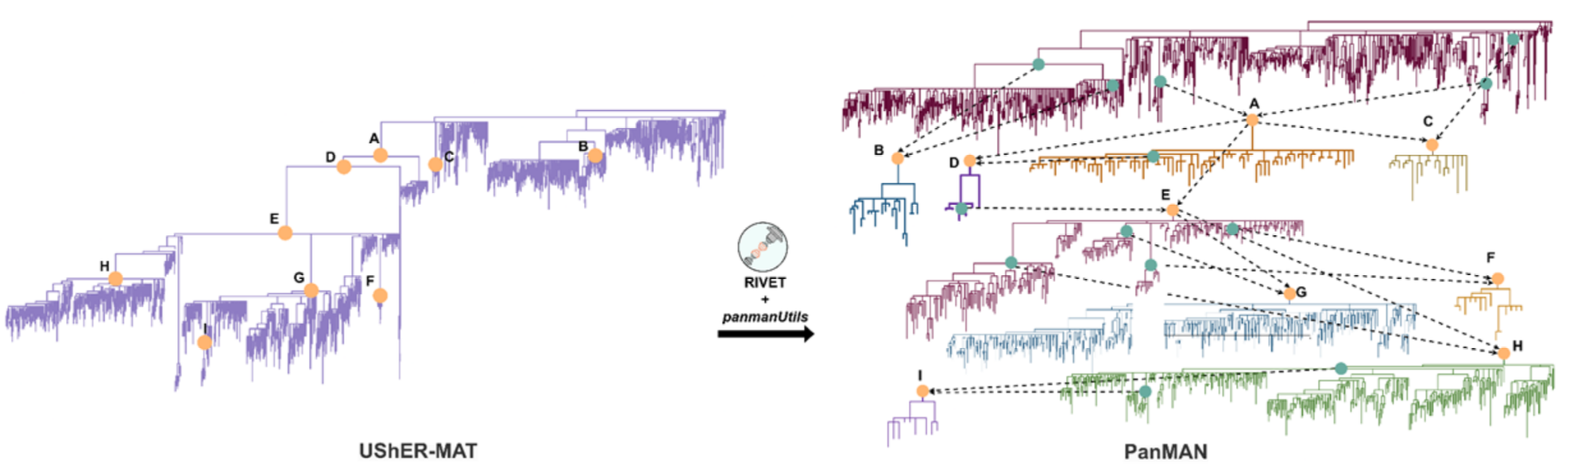
PanMAN tool developed at UCSD!
Notes:
PanMAN Tool
PanMAN is used to analyze and visualize pangenomes which is especially useful for studying the genetic mutations in viruses like COVID and other microbial datasets
Composed of mutation-annotated trees called PanMATs (Phylogenetic Analysis of Novel Mutations and Transmissions)
Image: Exploration of SARS-CoV-2 mutational and evolutionary landscape using PanMAN
UShER-MAT: another MAT tool, cannot represent complex mutations
Useful because:
By annotating mutations on different branches of the tree it is easier to quickly identify and analyze genetic changes which could be affecting its severity, resistance to vaccines, and transmissibility
https://turakhia.ucsd.edu/PPTs/PanMAN-Oxford-2024.pdf

Slide 8

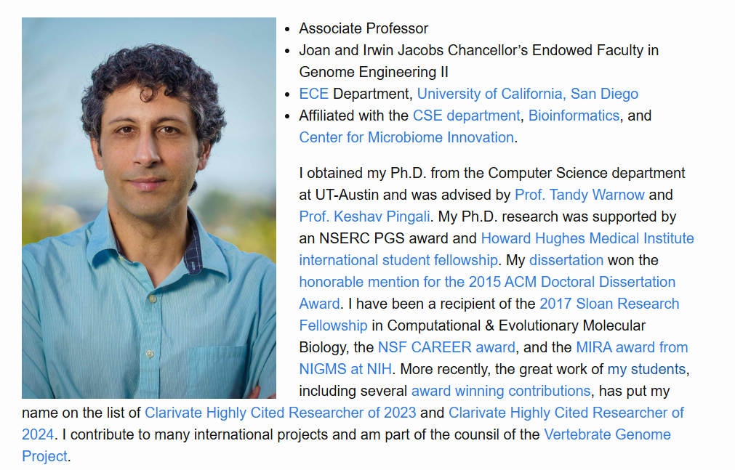
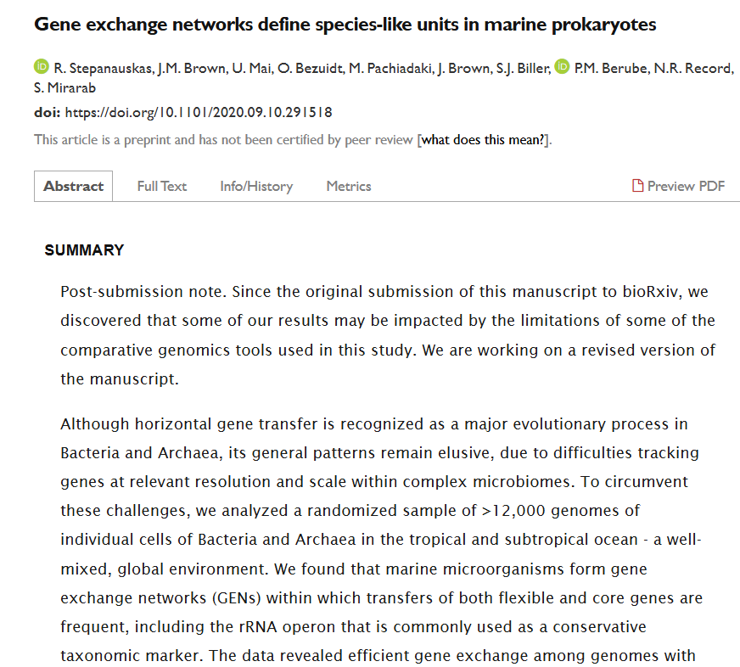
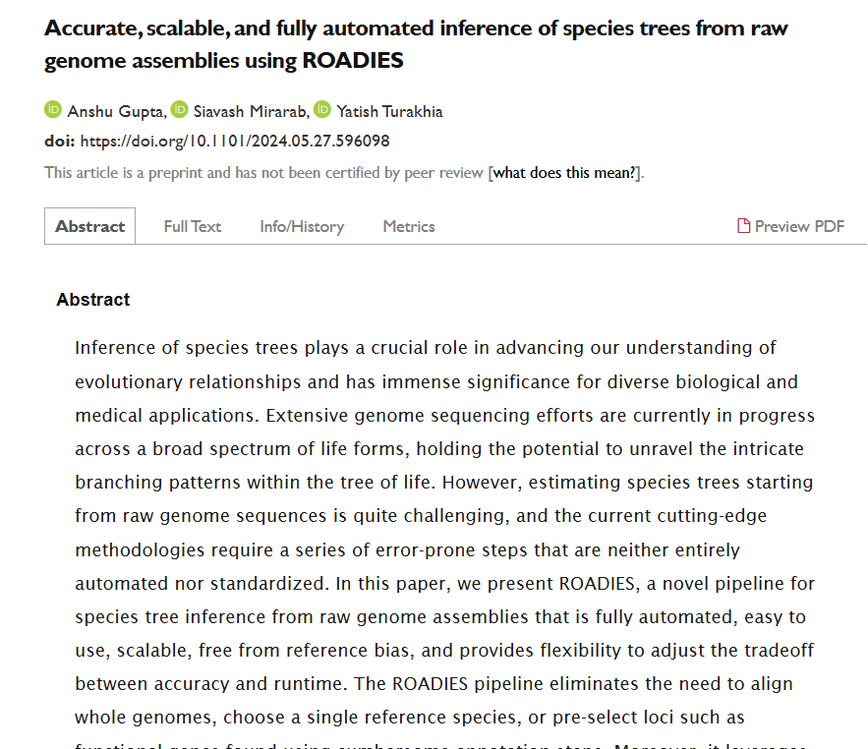
Labs at UCSD
Turakhia lab
Mirarab lab

